Slide 1
The future of technology & teaching: the always on teacher

Slide 2
Contents
How to use this guide
Why refresh our staff wellbeing strategy?
Roles and responsibilities
Questions to ask each department
Align and assign actions
Formalise goals
Measuring success
What’s next?
Further reading
Helpful hint These links are clickable.

Slide 3
How to use this guide
Using Microsoft PowerPoint?
First, decide if you or someone else is best suited to leading a project to evolve your staff wellbeing strategy.
Work through the first part of this guide together, assigning key roles and responsibilities. Try to include as many areas of school as possible.
Discuss specific topics with staff members, outlined in the section for their attention.
Assign action points, based on these discussions. It’s helpful to agree a realistic timeframe at this point.
Finally, decide how to measure success — plan short and long-term outcomes.
Save the guide as a template to personalise it

Slide 4
Why refresh our staff wellbeing strategy?
The latest industry research

Slide 5
Why refresh our staff wellbeing strategy?
Almost all educators say their work/life balance changed in 2020. Some for the better, some for the worse.*
But now, the way teachers work has changed. Educators are under new pressure to learn new skills, take a digital-first approach, and provide support in new, different ways.
Many schools would benefit from a refreshed wellbeing strategy. One that takes learnings from lockdown and the future of teaching into consideration.
*Source: The State of Technology in Education Report 2020/21

Slide 6
Why refresh our staff wellbeing strategy?
The industry view
Almost all educators expect technology to seamlessly blend with traditional teaching methods over the next 10 years.*
Lockdown has confirmed that students are best placed to learn in classrooms, with fair and equal access to technologies and skilled teachers that support their learning journeys. It clearly showed which technologies are most valuable — those that encourage collaboration and engagement such as front of class solutions like Promethean's ActivPanels.
*Source: The State of Technology in Education Report 2020/21

Slide 7
Why refresh our staff wellbeing strategy?
Observations at [school name]
Use this space to record your observations (Delete)
The industry view
Teachers are under increasing pressure. Well-implemented education technology can free up time, when used effectively. As well as boosting student engagement, ActivPanels can help to ease the administrative burden by streamlining manual processes, lesson preparation and assessment tasks.
*Source: The State of Technology in Education Report 2020/21

Slide 8
Ultimately…
This year’s State of Technology in Education report found educators seeing increased value in tried and tested tech, from a wellbeing and time-saving perspective.
This guide aims to help senior school staff understand more about the tech teachers rely on in the classroom, and the benefits IT staff see in it, so that work/life balance and wellbeing can be readdressed with support from more effective tech use.

Slide 9
This is a step-by-step guide to gathering feedback from school colleagues to ensure your wellbeing strategy addresses everyone’s needs and leans on tech to best advantage.

Slide 10
Roles and responsibilities
Who is leading the project?
SLT member/s
IT Staff
Teacher/s
Others

Slide 11
Questions to ask each department
Make a note of answers and outcomes

Slide 12
Questions for SLT (1/3)
What are your main concerns and considerations for staff, from a wellbeing perspective?
What type of learning environment would you like to see within our school in five years time? (Digital-first, hybrid/blended, interactive learning etc.)

Slide 13
Questions for SLT (2/3)
What tools / technologies would help create this environment? - Front of class solutions: - Communication platforms: - Lesson delivery software: Name specific hardware and software options like Promethean ActivPanel or ActivInspire.
How has school work/life balance changed since lockdown?

Slide 14
Questions for SLT (3/3)
What tools could help improve this balance, and free up teachers’ time? - Front of class solutions: - Communication platforms: - Lesson delivery software: Name specific hardware and software options like Promethean ActivPanel or ActivInspire.
What additional practices / initiatives could be adopted to improve staff wellbeing?

Slide 15
Questions for IT managers (1/2)
What are your personal concerns and considerations, from a wellbeing perspective?
What classroom tech would you like to see within our school in five years time? Name specific hardware and software options like Promethean ActivPanel or ActivInspire.
How has your work/life balance changed since lockdown?

Slide 16
Questions for IT managers (2/2)
What are your department’s tech recommendations to improve this balance? (Name specific hardware and software options like Promethean ActivPanel or ActivInspire.)
What additional practices / initiatives do you think the school should adopt to improve staff wellbeing?

Slide 17
Questions for teachers (1/2)
What are your personal concerns and considerations, from a wellbeing perspective?
What type of learning environment would you like to see in your classrooms in five years’ time?
What tools / technologies would help create this environment? (Name specific hardware and software options like Promethean ActivPanel or ActivInspire.)

Slide 18
Questions for teachers (2/2)
How has your work/life balance changed since lockdown? (What did you miss about the classroom? How was student engagement impacted by remote learning?)
How has your work/life balance changed since lockdown? (What did you miss about the classroom? How was student engagement impacted by remote learning?)
What additional practices / initiatives could the school roll out to improve staff wellbeing?

Slide 19
Align and assign actions
Plan a meeting to outline goals

Slide 20
Align and assign actions (1/3)
Once each department has completed their section of this document, chair a meeting with everyone involved. Proposed agenda:
Wellbeing and healthy working goals for the school and each department Discuss where goals and tools overlap, where they are different, and why.
Priorities / changes since lockdown School, pupils, teachers, support, admin, health, work/life balance?

Slide 21
Align and assign actions (2/3)
How edtech can help address these goals and changes Reduce workload, improve processes, enhance lesson delivery, improve pupil behaviour. Call out specific tech and how they’d help - like ActivPanels improving student engagement.
What extra requirements are there to consider? Technology roadmap, training, govt regulation, network, safeguarding, budget?

Slide 22
Align and assign actions (3/3)
Each department’s proposal to address the above within the wellbeing strategy Brainstorm ideas before submitting final proposal.

Slide 23
Formalise objectives
Put your refreshed wellbeing strategy into writing

Slide 24
Formalise objectives (1/2)
Goals | Actions (who and what) | Expected completion date
Goal 1 Eg. Wellbeing strategy proposal: work/life balance goals aligned to specific tools like an ActivPanel
Goal 2 Eg. Approval: sign off from SLT, teachers, other departments
Goal 3 Eg. Roll out: tech deployment, launch new staff initiatives, scheduling, licenses, training, communication

Slide 25
Formalise objectives (2/2)
Goals | Actions (who and what) | Expected completion date
Goal 4 Eg. Staff training and edtech support requirements
Goal 5 Eg. Assessment of wellbeing goals and achievements against wellbeing strategy

Slide 26
Measuring success
Did the wellbeing strategy meet its goals?

Slide 27
Measuring success
Finally, assess the goals and timelines for your wellbeing strategy. Did it meet its objectives?
Goals | Team responsible | Details | Completion date | Assessment date | Next steps?
Goal 1
Goal 2
Goal 3
Goal 4
Goal 5

Slide 28
What’s next?
Work through our other guide, Schools’ strategic goals: a hybrid learning strategy, to make sure you’re preparing for a digital-first future that helps reduce the attainment gap.
Further considerations when updating your school’s technology
If you’re in the process of addressing your school’s wider edtech needs this year, there are other considerations.
Have you planned your school’s hybrid learning strategy, for instance?

Slide 29
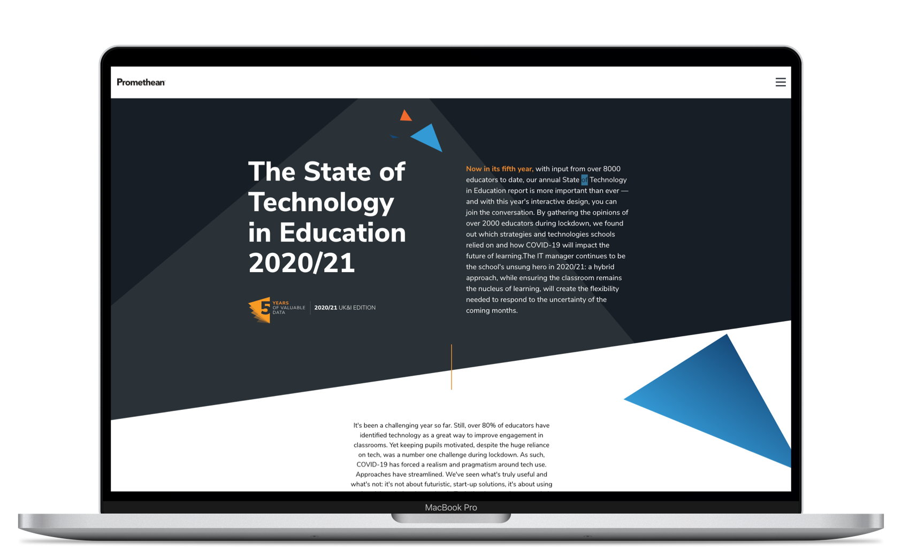
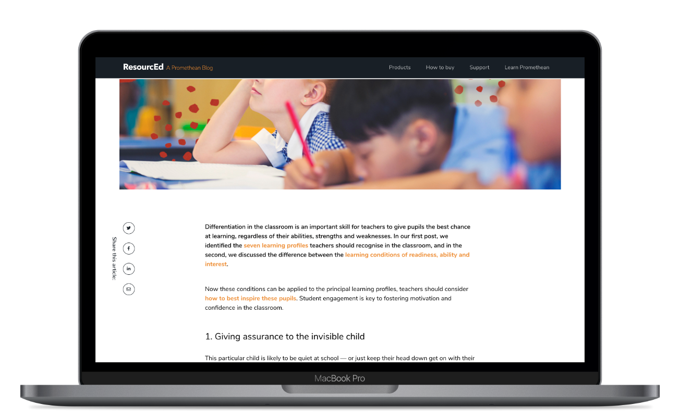
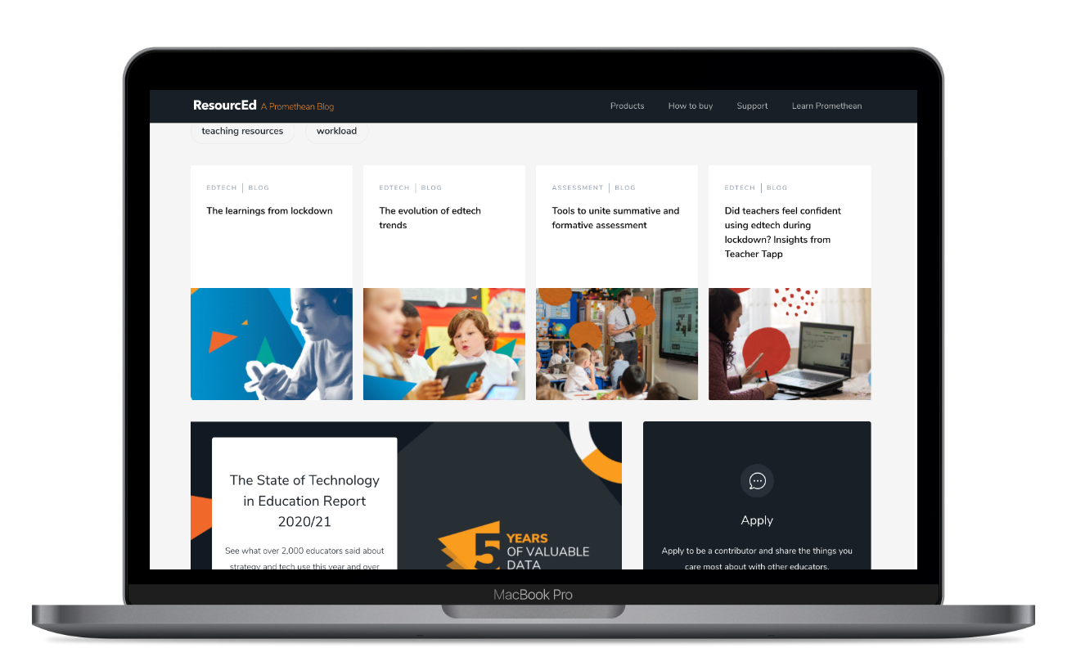
Further reading
The State of Technology in Education Report 2020/21
Request an ActivPanel demo
5 ways for teachers to keep the mind healthy and cope with change.
Your thoughts on an outstanding school — wellbeing vs achievement.

Slide 30
Improving your staff wellbeing
Out of date, ineffective tech is a drain on teachers’ time and causes additional stress. Promethean's front-of-class technology, meanwhile, is designed to improve pupil engagement and behaviour. Get in touch to arrange a free demo, and find out why an ActivPanel is a future-proof tool that helps to create a positive digital-first environment throughout the school.

