Slide 1
Budgets: strategic tech spending

Slide 2
Contents
How to use this guide
Why review our edtech budget?
Roles and responsibilities
Questions to ask each department
Align and assign actions
Formalise goals
Measuring success
What’s next?
Further reading
Helpful hint These links are clickable.

Slide 3
How to use this guide
Using Microsoft PowerPoint?
First, decide if you or someone else should lead your edtech budgeting exercise.
Work through the first part of this guide together, assigning key roles and responsibilities. Try to include as many areas of school as possible.
Discuss specific topics with staff members, outlined in the section for their attention.
Assign action points, based on these discussions. It’s helpful to agree a realistic timeframe at this point.
Finally, decide how to measure success — plan short and long-term outcomes.
Save the guide as a template to personalise it

Slide 4
Why review our edtech budget?
The latest industry research

Slide 5
Why review our edtech budget?
There’s never enough money for everything a school would like. But data shows that not enough is being invested in edtech.*
Schools strive to improve attainment and engagement and, where properly considered and evaluated, education technology can support these goals.
Agile budgeting means planning your IT costs either monthly or for each term. That way, you can calculate exactly how much each term or project is going to cost, based on pupils’ needs, school’s goals and the current (ever-shifting) landscape.
*Source: The State of Technology in Education Report 2020/21

Slide 6
Why review our edtech budget?
Observations at [school name]
Use this space to record your observations (Delete)
The industry view
IT budget setting isn’t always a collaborative project.
IT managers have lost confidence in their schools’ IT budgets: 46% were happy with the investments in 2016. Only 19% said the same in 2020.*
Front-of-class tech like a Promethean ActivPanel provides low total cost of ownership, whilst boosting attainment and engagement year-on-year. Without collaboration across teams, our edtech budget may fail to align these broader goals to the tech decisions we make.
*Source: The State of Technology in Education Report 2020/21

Slide 7
Ultimately…
An agile edtech budget, taking onboard the schools’ ever-changing needs and considerations, should help address SLT’s, teachers’ and IT managers’ investment concerns.

Slide 8
This is a step-by-step guide to gathering feedback from all school staff to ensure your edtech budget addresses everyone’s needs.

Slide 9
Roles and responsibilities
Who is leading the project?
SLT member/s
IT Staff
Teacher/s
Others

Slide 10
Questions to ask each department
Make a note of answers and outcomes

Slide 11
Questions for SLT (1/3)
What improvements do we want to make to learning this academic year? (Raising attainment, closing attainment gap, more digital learning, create interactive environments etc.)
How could edtech support these goals? Name specific hardware and software options like Promethean ActivPanel or ActivInspire.
What are the current annual budgeting processes, and who are the stakeholders?

Slide 12
Questions for SLT (2/3)
What budget proportion / value is currently allocated to classroom technology? Is there scope for adjustment?
Is training required? Is it currently paid for, or free?
How could we acquire technology or funding via other means?

Slide 13
Questions for SLT (3/3)
What are your biggest concerns about allocating more budget to front of class and other classroom technologies?

Slide 14
Questions for IT managers (1/2)
What are your department’s classroom tech recommendations for the academic year? Name specific hardware and software options like Promethean ActivPanel or ActivInspire.
What classroom tech would you like to see within our school in five years time?
What changes would you like to see to our current budgeting processes?

Slide 15
Questions for IT managers (2/2)
Can we repurpose existing hardware and software to preserve budget?
Has a software license audit taken place recently? Can any licenses be redeployed or changed?
What are your biggest concerns about changing IT budgeting processes?

Slide 16
Questions for teachers (1/2)
What are your primary and secondary goals within your classroom this academic year? (Improve behaviour, boost engagement, better differentiation, try blended learning techniques etc?)
What type of learning environment would you like to see within our school in five years time, regardless of budget?
Where do you think IT investment should be made? Name specific hardware and software options like Promethean ActivPanel or ActivInspire.

Slide 17
Questions for teachers (2/3)
What are your most common frustrations with the tech we have today? Broken hardware, poor support, for example. Would you benefit from more training?
Where do you think IT budget is currently being wasted / misplaced?
Are teachers consulted on the IT budgeting process? If not, why do you think you should be involved?

Slide 18
Align and assign actions
Plan a meeting to outline goals

Slide 19
Align and assign actions (1/3)
Once each department has completed their section of this document, chair a meeting with everyone involved. Proposed agenda:
High-level goals for the school and each department Discuss where goals overlap, where they are different, and why.
Priorities / changes this year Have costs, considerations and budget allocations changed since lockdown? What will still be relevant over the coming years?

Slide 20
Align and assign actions (2/3)
How existing technology can reduce the existing budget Where are our opportunities to adapt or redeploy hardware, software, licenses, etc.?
What requirements are there to consider? Govt funding, training requirements, infrastructure investment, safeguarding priorities?

Slide 21
Align and assign actions (3/3)
Each department’s proposal for redistributing the IT budget Brainstorm ideas before submitting final proposal.

Slide 22
Formalise objectives
Putting our redistributed budget into writing

Slide 23
Formalise objectives (1/2)
Goals | Actions (who and what) | Expected completion date
Goal 1 Eg. New budget process planning: timeframes, stakeholders, school goals.
Goal 2 Eg. Approval: sign off from SLT, teachers, other departments.
Goal 3 Eg. Define new budget, including new investments and redeployments.

Slide 24
Formalise objectives (2/2)
Goals | Actions (who and what) | Expected completion date
Goal 4 Eg. Roll out: investment in tools, software, training etc.
Goal 5 Eg. Assessment of final expenditure compared to budget allocated.

Slide 25
Measuring success
Did the roadmap meet its goals?

Slide 26
Measuring success
Finally, assess the budget process and scope. Did it meet its objectives?
Goals | Team responsible | Details | Completion date | Assessment date | Next steps?
Goal 1
Goal 2
Goal 3
Goal 4
Goal 5

Slide 27
What’s next?
Work through our other guide, Staff training: the skills to support the edtech strategy, to make sure you’re considering the longevity of your investments.
Further considerations when updating your school’s technology
If you’re in the process of addressing your school’s wider edtech needs this year, there are other considerations.
Have you considered the need for new or adapted staff training to ensure edtech is used most appropriately, to get the most out of your budget allocation?

Slide 28
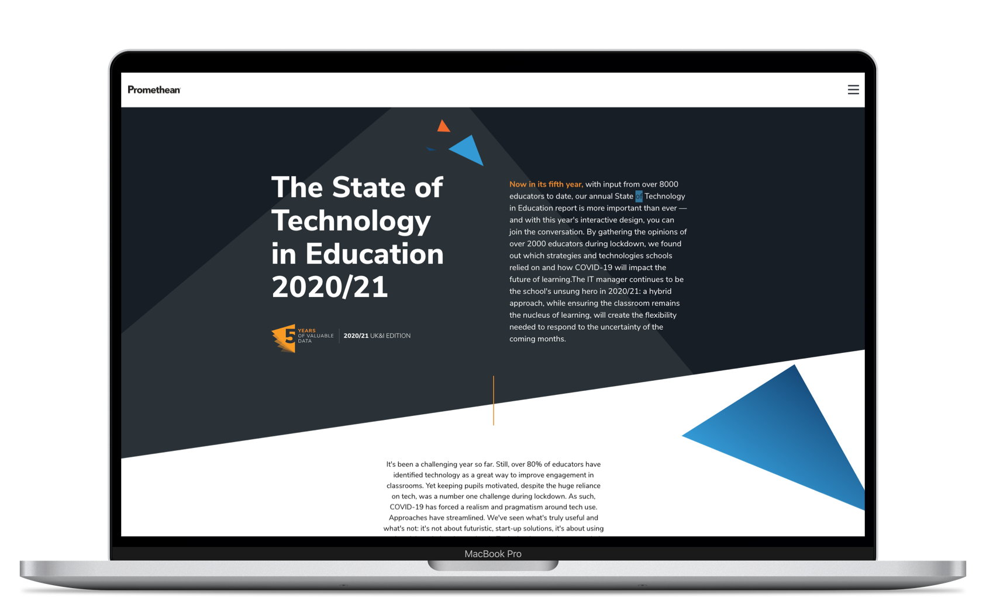
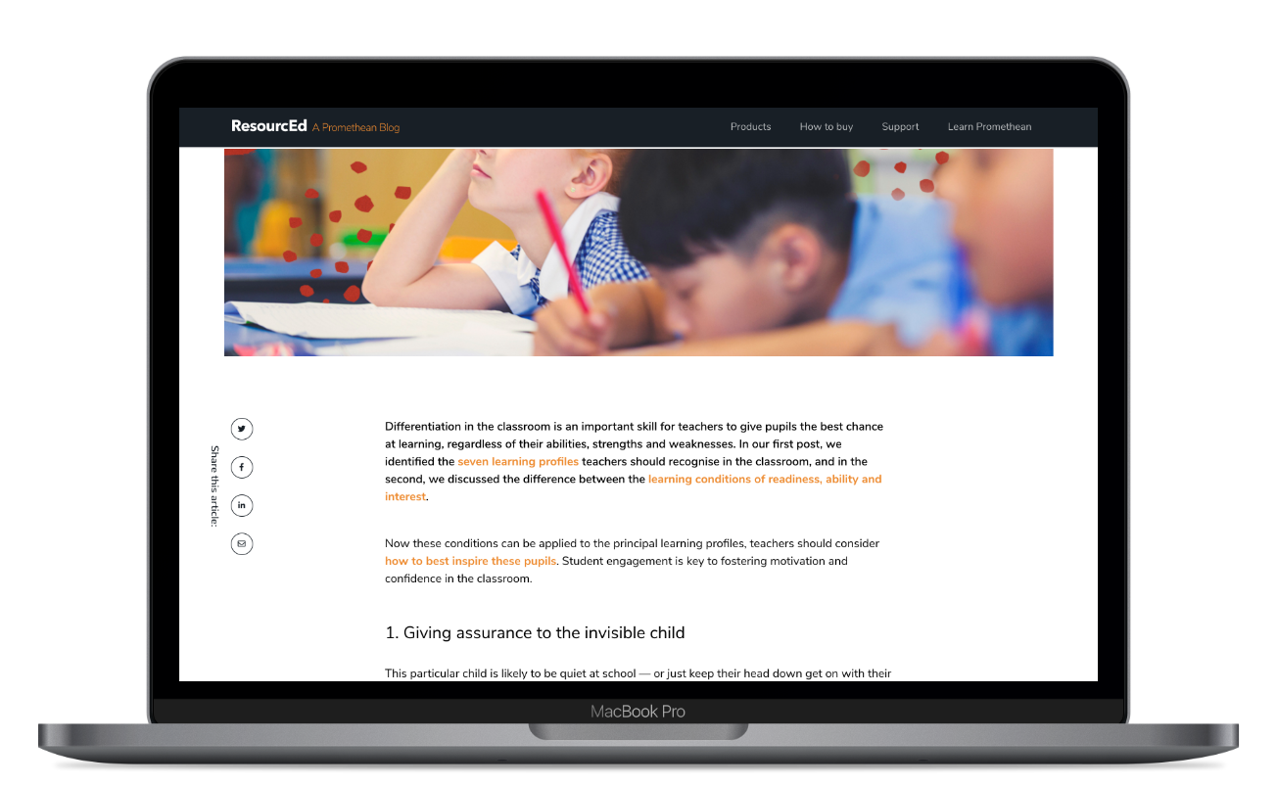
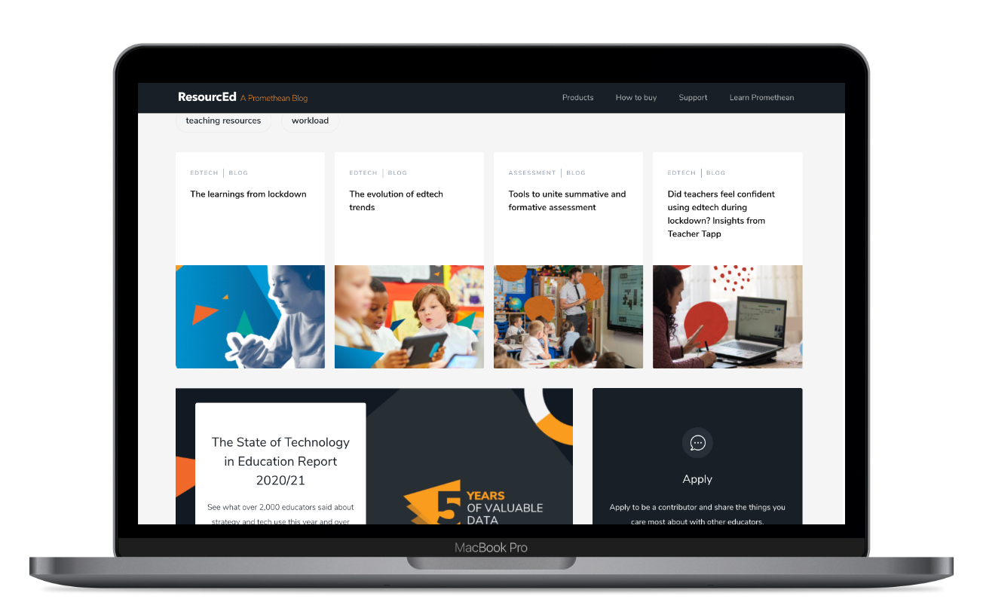
Further reading
The State of Technology in Education Report 2020/21
Request an ActivPanel demo
How an agile tech budget helps schools in uncertain financial times.
Budget boundaries — how to optimise spend towards school objectives.

Slide 29
Improving your tech budget
Promethean's front-of-class technology is long-lasting with an upgradable operating system, so it has low total cost of ownership. Get in touch to arrange a free demo, and find out why an ActivPanel is a future-proof IT investment.

