Slide 1
Schools’ strategic goals: a hybrid learning strategy

Slide 2
Contents
How to use this guide
Why create a hybrid learning strategy?
Roles and responsibilities
Questions to ask each department
Align and assign actions
Formalise goals
Measuring success
What’s next?
Further reading
Helpful hint These links are clickable.

Slide 3
How to use this guide
Using Microsoft PowerPoint?
First, decide if you or someone else should lead your hybrid learning strategy.
Work through the first part of this guide together, assigning key roles and responsibilities. Try to include as many areas of school as possible.
Discuss specific topics with staff members, outlined in the section for their attention.
Assign action points, based on these discussions. It’s helpful to agree a realistic timeframe at this point.
Finally, decide how to measure success — plan short and long-term outcomes.
Save the guide as a template to personalise it

Slide 4
Ultimately…
A hybrid learning strategy, with a whole-school approach, should holistically combine the school’s strategic goals, whilst maximising pedagogy, technology and available space inside and outside classrooms.

Slide 5
Why create a hybrid learning strategy?
The latest industry research

Slide 6
Why create a hybrid learning strategy?
The global pandemic has accelerated the uptake of digital tools and technologies in the classroom. Indeed, almost all (90%) educators expect technology to seamlessly blend with traditional teaching methods over the next 10 years.*
The National Education Union has since recommended blended, or hybrid learning – an approach to education that blends interaction on online/digital learning tools and platforms, like Promethean ActivPanels and ActivInspire, with traditional classroom methods to create learner-centred experiences
Still, the classroom is the best place for student engagement. So, many schools need to create a hybrid learning strategy for 2020/21. One that helps overcome digital learning curves and increases teachers’ confidence using classroom edtech while preparing for uncertain times ahead.
*Source: The State of Technology in Education Report 2020/21

Slide 7
Why create a hybrid learning strategy?
Observations at [school name]
Use this space to record your observations (Delete)
The industry view
A quarter of educators believe technology will positively impact student education in the coming years. But three quarters believe lack of access is a barrier for learning.*
A hybrid learning strategy gives all pupils access to a digital-first learning environment in school and provides a back up for when pupils can’t be in class, whilst arming teachers with the skills to make the most of these tools, today and tomorrow.
It’s critical to keep the classroom at the centre of the learning experience. Front-of-class tech, like Promethean ActivPanels, boosts pupil engagement and reduces learning curves while preparing pupils and teachers for a digital future.
*Source: The State of Technology in Education Report 2020/21

Slide 8
This is a step-by-step guide to gathering feedback from all school staff to ensure your hybrid learning strategy addresses everyone’s needs.

Slide 9
Roles and responsibilities
Who is leading the project?
SLT member/s
IT Staff
Teacher/s
Others

Slide 10
Questions to ask each department
Make a note of answers and outcomes

Slide 11
Questions for SLT (1/2)
What improvements do we want to make to learning this academic year? Raising attainment, closing attainment gap, more digital learning, create interactive environments etc.
How have online collaboration processes and lesson delivery methods changed?
Do staff need more edtech training to support them in implementing a hybrid learning approach?

Slide 12
Questions for SLT (2/2)
Is there a digital divide amongst pupils / families? How can we address this with classroom edtech tools?
What budget proportion / value is currently allocated to edtech? Is there scope for adjustment?
What are your key concerns about a hybrid learning strategy?

Slide 13
Questions for IT managers (1/2)
What are your department’s edtech recommendations for the academic year? Name specific hardware and software options like Promethean ActivPanel or ActivInspire.
What new platforms and connected devices have been deployed this year? What is on the roadmap?
Do these tools support a hybrid learning approach?

Slide 14
Questions for IT managers (2/2)
Are all school staff confident using these tools? Are they aware of potential online threats and vulnerabilities?
Is enough budget allocated to etech training and online security to support a hybrid learning strategy? Is there scope for adjustment?
What are your key concerns about a hybrid learning strategy from a security and safeguarding perspective?

Slide 15
Questions for teachers (1/2)
What are your primary and secondary goals within your classroom this academic year? Improve behaviour, boost engagement, better differentiation, try blended learning techniques etc?
What new platforms and connected devices are you and your pupils using this year?
Are you confident using these tools? Would you benefit from further training?

Slide 16
Questions for teachers (2/2)
Is there a big digital divide amongst pupils / families? How can we address this with classroom edtech tools?
Do you think enough time is allocated to edtech training? Would you prefer more?
What are your key concerns about a hybrid learning strategy?

Slide 17
Align and assign actions
Plan a meeting to outline goals

Slide 18
Align and assign actions (1/3)
Once each department has completed their section of this document, chair a meeting with everyone involved. Proposed agenda:
High-level IT goals for the school and each department Discuss where goals overlap, where they are different, and why.
Learning requirements, edtech usage and process changes for a hybrid learning approach Tools, hardware, online platforms, collaboration tools, video conferencing etc

Slide 19
Align and assign actions (2/3)
What new security considerations could a hybrid learning strategy generate? Data security, points of weakness, patching, update compliance, device security, cyber-bullying
Scheduling regular edtech and online security training Are all staff aware of security protocols and best practice? Internet restrictions and connecting to the network etc.

Slide 20
Align and assign actions (3/3)
Each department’s proposal to the hybrid learning strategy Brainstorm ideas before submitting final proposal.

Slide 21
Formalise objectives
Putting our hybrid learning strategy
into writing

Slide 22
Formalise objectives (1/2)
Goals | Actions (who and what) | Expected completion date
Goal 1 Eg. Hybrid strategy proposal: IT goals aligned to specific tools like ActivPanels.
Goal 2 Eg. Approval: sign off from SLT, teachers, other departments.
Goal 3 Eg. Roll out: due diligence, deployment, process updates, communication to rest of school.

Slide 23
Formalise objectives (2/2)
Goals | Actions (who and what) | Expected completion date
Goal 4 Eg. Edtech training: best use of tools, online security best practice..
Goal 5 Eg. Assessment of hybrid learning goals and achievements against the new strategy.

Slide 24
Measuring success
Did the hybrid learning strategy meet its learning goals?

Slide 25
Measuring success
Finally, assess the goals and timelines of your strategy. Did it meet its objectives?
Goals | Team responsible | Details | Completion date | Assessment date | Next steps?
Goal 1
Goal 2
Goal 3
Goal 4
Goal 5

Slide 26
What’s next?
Work through our other guide, Tech use: a refreshed tech roadmap, to make sure you’re taking the whole school’s needs into account.
Further considerations when updating your school’s technology
If you’re in the process of addressing your school’s wider edtech needs this year, there are other considerations.
Have you carefully planned your edtech roadmap for the coming year, for instance?

Slide 27
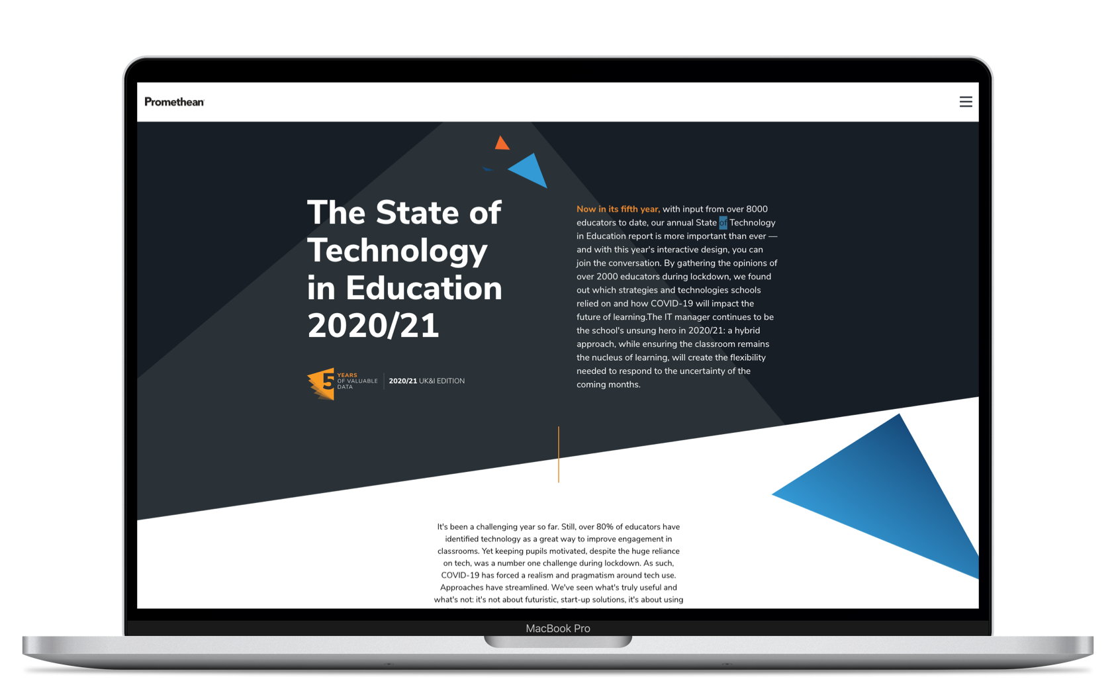
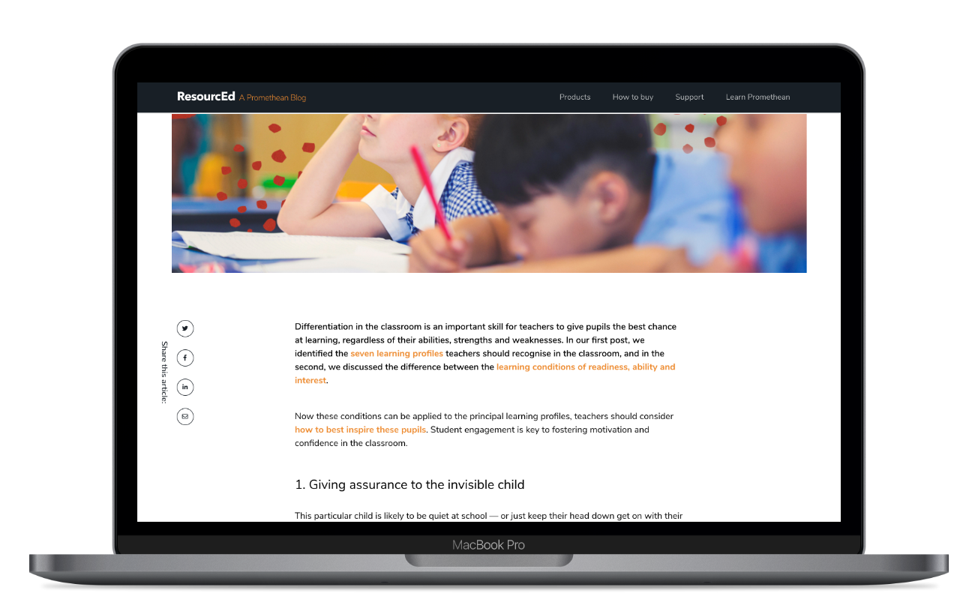
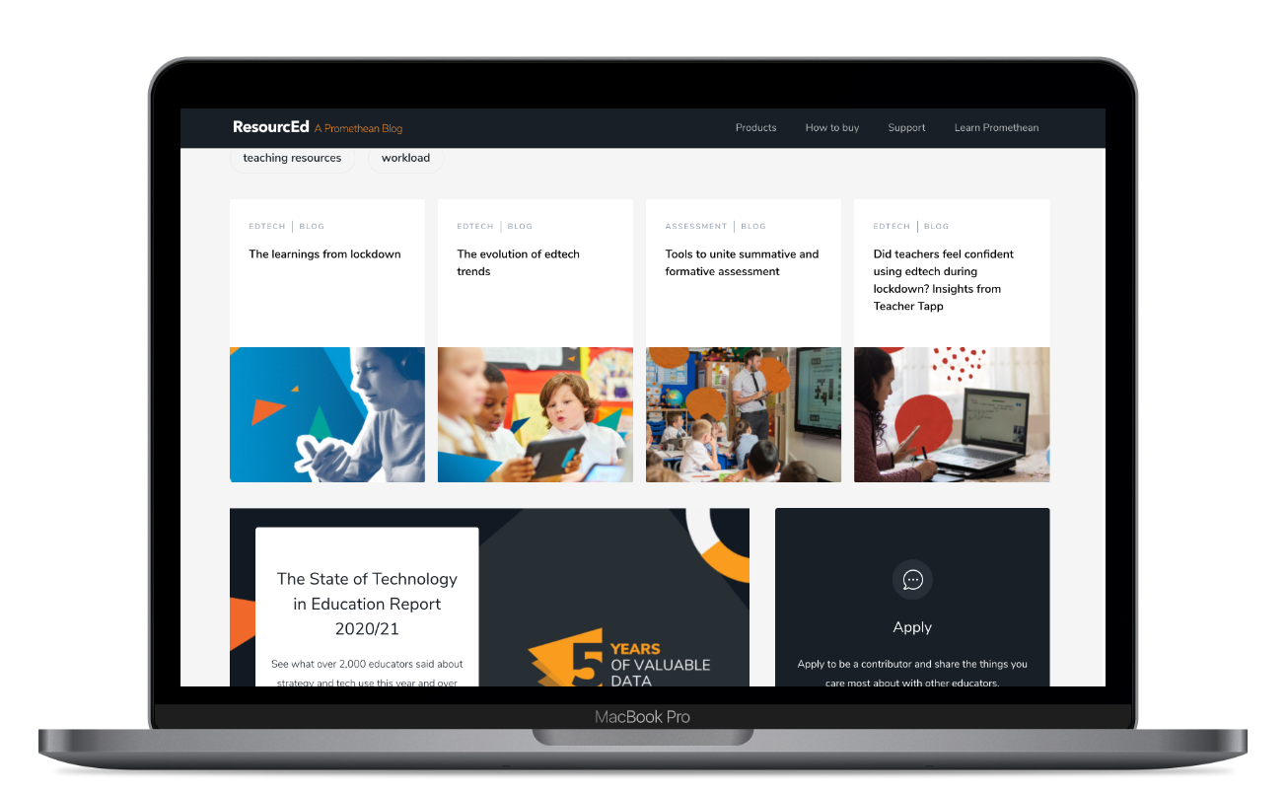
Further reading
The State of Technology in Education Report 2020/21
Request an ActivPanel demo
What should student data really be used for?
When should your school IT safeguarding policies be updated, and why?

Slide 28
Improving your hybrid learning approach
Since lockdown, schools recognise the value of technology for communication with pupils, parents and colleagues. Still, the pandemic highlighted a gap in appropriate tools, as well the agility and flexibility to deliver equal learning outside classrooms. Promethean's front-of-class technology helps schools implement a future-proof hybrid learning strategy by maximising the pillars that underpin it — pedagogy, technology and available space.
Get in touch to arrange a free demo, and find out how the teacher-centric ActivPanel can drive a pedagogical strategy for ICT usage, as part of a well-crafted digital learning strategy.

